Slide 1
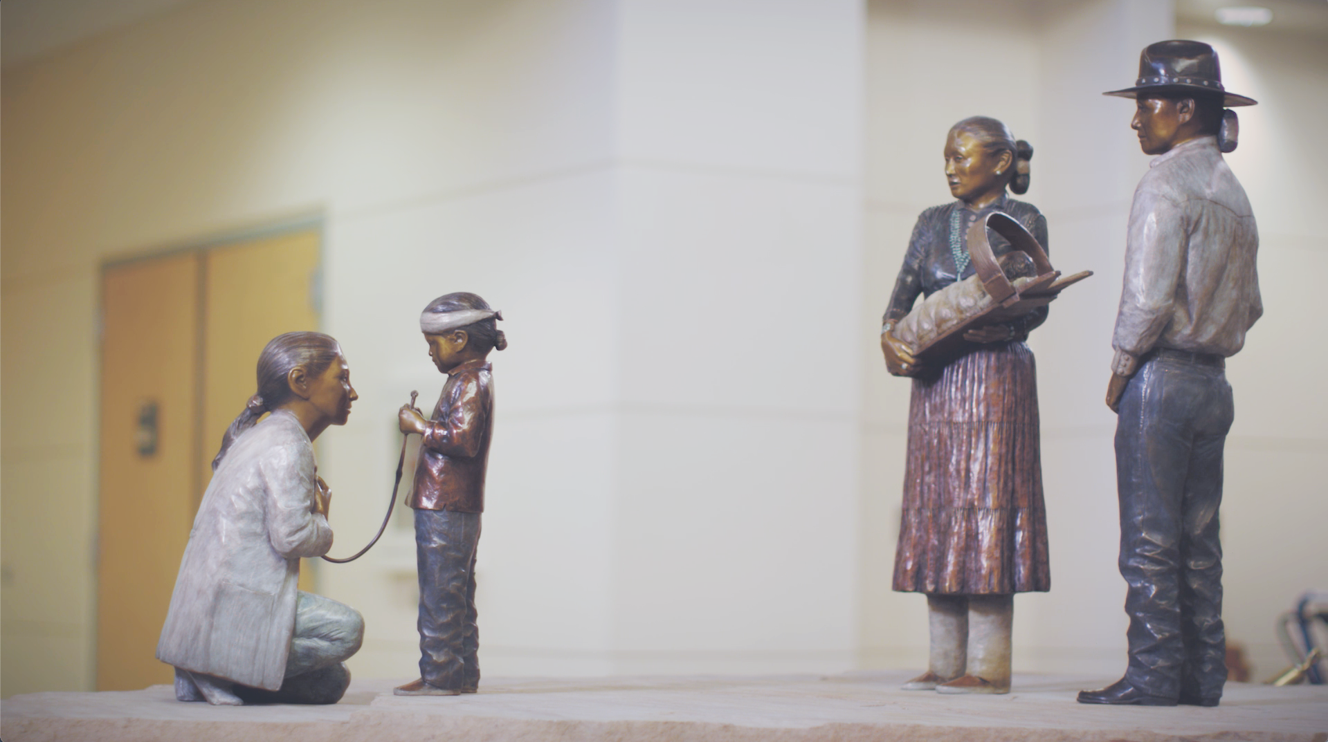

Fort Defiance Indian Hospital Board, Inc.
AISDH Annual Meeting
July 24, 2026
Naomi Jean Young, MD
Chief Executive Officer
Naomi.Young@fdihb.org
Optional Subheading Here

Slide 2

FDIHB, Inc. Leadership
FDIHB Board President Roxanne Gorman
FDIHB Board Vice President Benjamin Dodge
FDIHB Board Treasurer Juanita J. Martinez
FDIHB Board Secretary Laura M. Mike, Ph.D.
FDIHB Board Member Floyd Ashley
FDIHB Board Member Dawn Yazzie
Acting Chief of Administration Darrin Teller
Chief of Finance Christine Becenti
Chief of Healthy Living and Outreach CMDR Leah Earl-Begay
Chief of Human Resources Gary Pahe
Interim Chief Medical Officer Aaron Price, MD
Chief Nursing Officer Sharon Edison
Chief of Quality Services Netrisha Dalgai
Chief Information Security Brandon Benallie
Fort Defiance Indian Hospital Board Inc.
fdihb.org | 928.729.8000

Slide 3
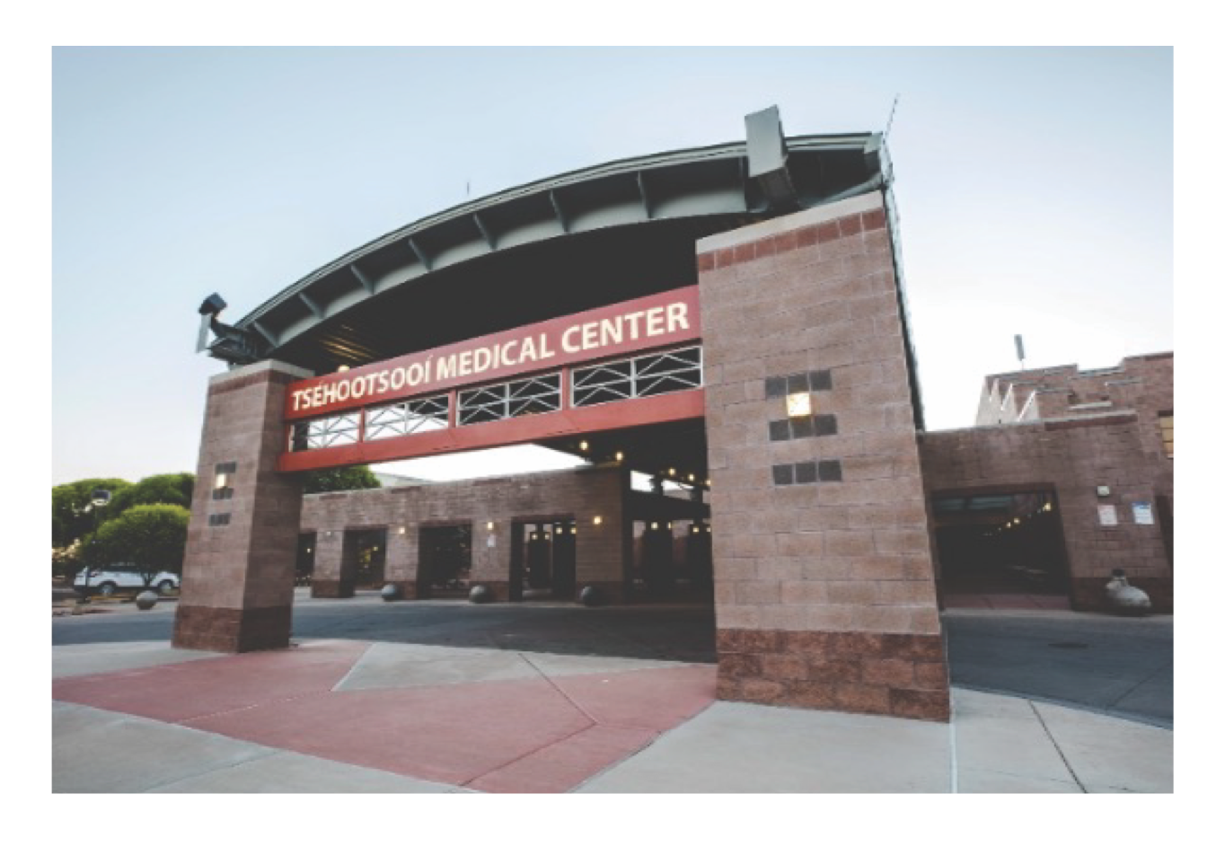
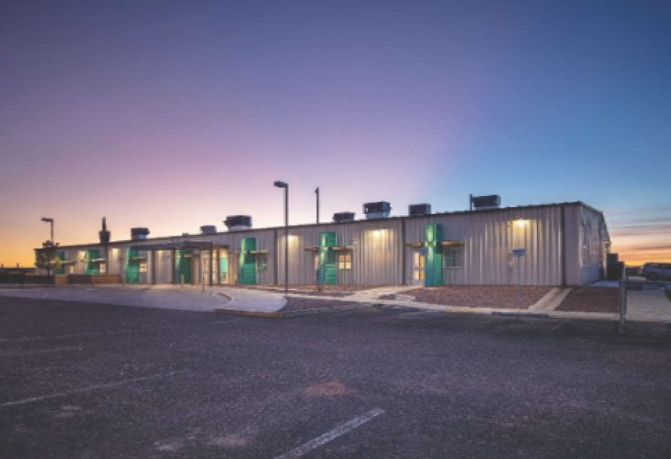
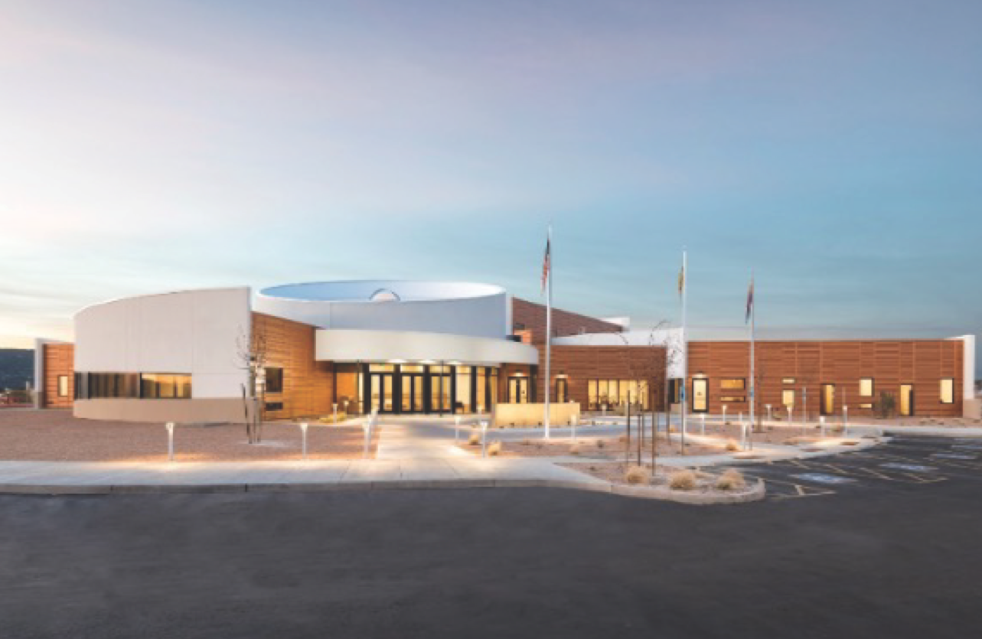
FDIHB Mission Statement
To provide superior and compassionate healthcare to our community by raising the level of health, Hózhó and quality of life.
Tsehootsooi Medical Center
Fort Defiance, AZ
Nahata’Dziil Health Center
Sanders, AZ
Nihi Dine’e Ba
Wellness Center
Fort Defiance, AZ
Fort Defiance Indian Hospital Board Inc.
fdihb.org | 928.729.8000

Slide 4
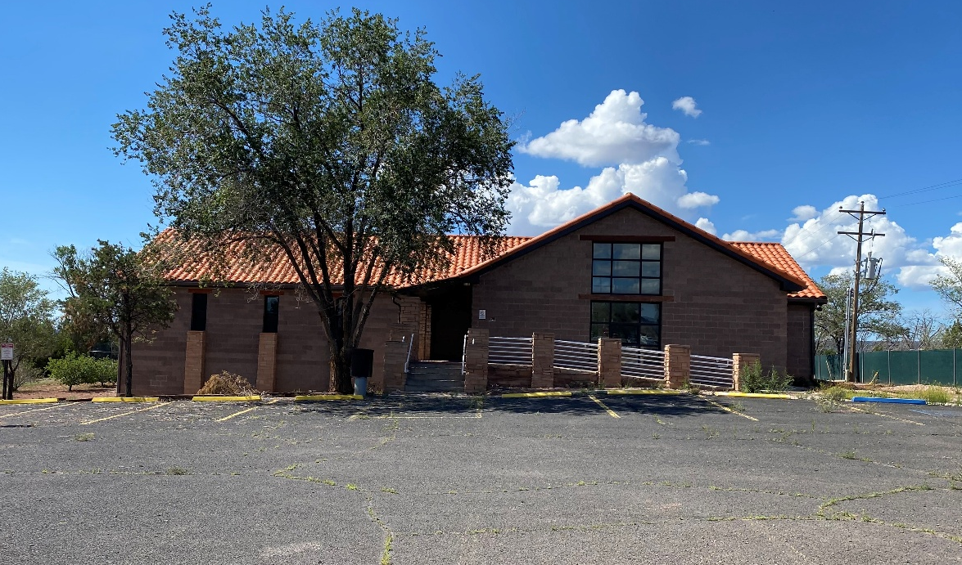

FDIHB Mission Statement
To provide superior and compassionate healthcare to our community by raising the level of health, Hózhó and quality of life.
FDIHB Ch’ithootsoi Business Office
St. Micheals, AZ
Fort Defiance Indian Hospital Board Inc.
fdihb.org | 928.729.8000

Slide 5
FDIHB Service Unit
16 COMMUNITIES
Crystal
Cornfields (Ganado)
Fort Defiance
Ganado
Greasewood
Houck
Kindalichee
Klagetoh
Lupton
Nahat’a Dziil
Oaksprings
Red Lake
Sawmill
St. Michaels
Steamboat (Ganado)
Wide Ruins
Service Population:
45,486
Fort Defiance Indian Hospital Board Inc.
fdihb.org | 928.729.8000

Slide 6
FDIHB Quality Services
CMS certification: June 2025
College of American Pathologists’ Laboratory Accreditation – Feb 2025
  Tsehootsooi Medical Center Laboratory
  Nahat’a Dziil
  Mobile Unit
  TMC Gallup Specialty Clinic
Board of Certification/Accreditation, DME Supplier Certification/Physical Therapy Durable Medical Equipment – April 2025
Patient Centered Medical Home Model: PENDING
Mammography Quality Standards Act (MQSA)
American College of Radiology (ACR) Mammography
FDA Accreditation for Screening and Diagnostic 3D Mammograms
JRSA Facility Assessment 6/2025
Fort Defiance Indian Hospital Board Inc.
fdihb.org | 928.729.8000

Slide 7
FDIHB Human Resources
Full Time Employees:
  1167 at end of June 2026
    1.2% turnover rate (5/2026)
Nursing
  Vacancy Rate: 38%
Medical Providers
  FTE 126
  Vacancy Rate: 26%
Fort Defiance Indian Hospital Board Inc.
fdihb.org | 928.729.8000

Slide 8
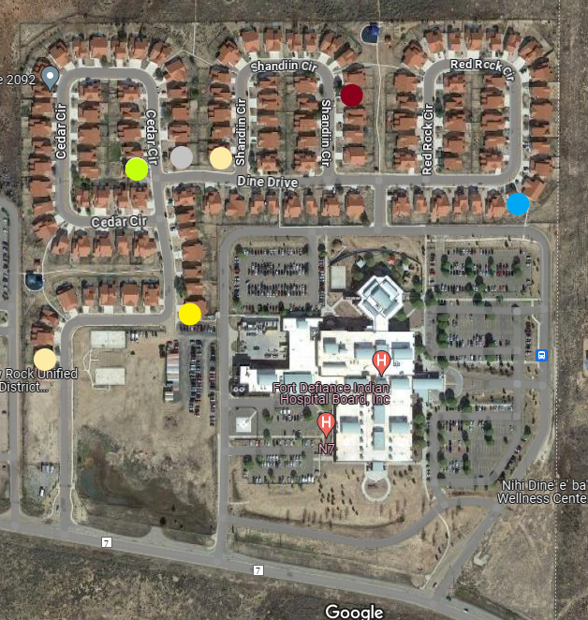
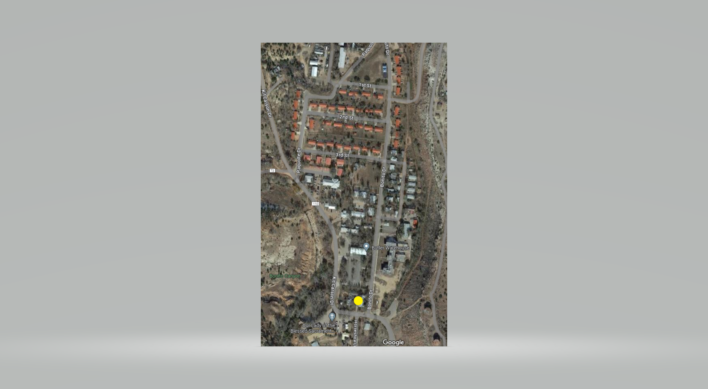
FDIHB Administration
Housing
New Hospital Housing
Old Hospital Housing
Fort Defiance Indian Hospital Board Inc.
fdihb.org | 928.729.8000

Slide 9
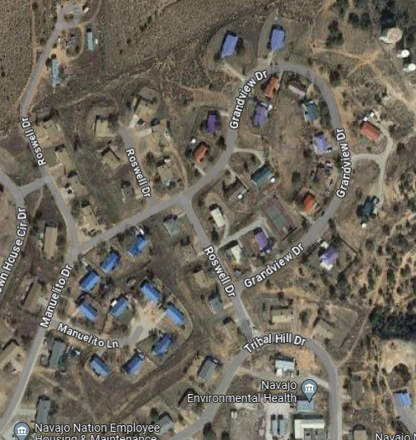
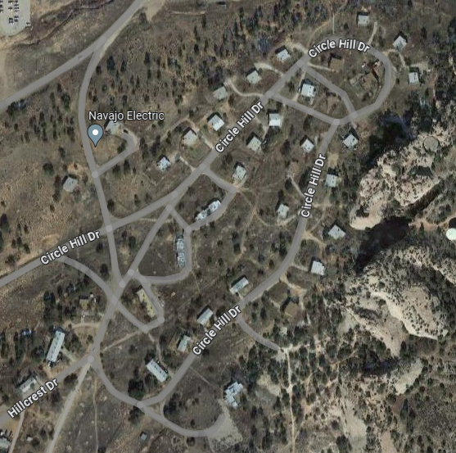
FDIHB Administration
Housing
Window Rock Housing
Window Rock Circle Drive Housing
Fort Defiance Indian Hospital Board Inc.
fdihb.org | 928.729.8000

Slide 10
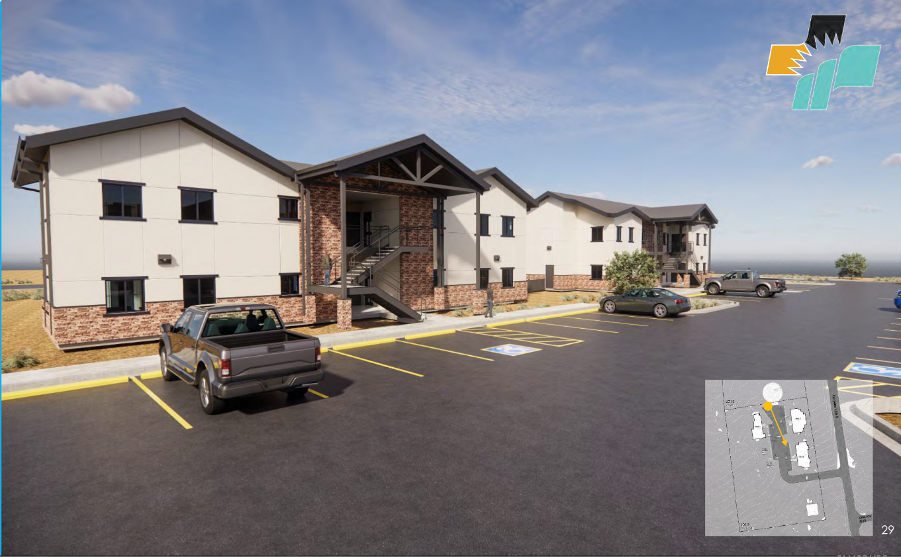
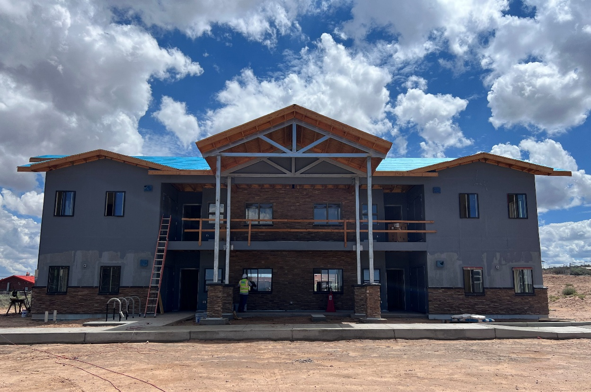
FDIHB Administration
Project Management and Housing
Nahat’a Dziil Employee Housing – expected January 2027
Fort Defiance Indian Hospital Board Inc.
fdihb.org | 928.729.8000

Slide 11
FDIHB Finance
Non-Emergent Medical Transport
  5 Cars
  609 Encounters for FY 2024
Fort Defiance Indian Hospital Board Inc.
fdihb.org | 928.729.8000 | @fdihbinc

Slide 12
FDIHB Medical and Nursing
OUTPATIENT
CLINIC | FY 23 | FY 24 | FY 25
ENT | 1,886 | 1,598 | 1,695
DENTAL | 15,973 | 16,891 | 19,573
MEDICAL NUTRITION THEAPY | 561 | 1,223 | 1,592
OB | 3,853 | 4,574 | 3,519
GYN | 4,636 | 4,038 | 4,346
GEN SURGERY | 6,408 | 5,950 | 6,238
RADIOLOGY | 21,763 | 22,009 | 23,041
LABORATORY | 15,175 | 9,396 | 15,135
NHDC-LAB | 793 | 765 | 1,595
PEDIATRIC | 12,137 | 12,093 | 10,146
OPTOMETRY | 9,752 | 6,662 | 7,360
OUTPATIENT MENTAL HEALTH | 7,275 | 8,055 | 8,321
RESPIRATORY | 460 | 424 | 326
PHARMACY | 94,701 | 90,783 | 125,890
PCC | 48,540 | 48,611 | 46,274
MOBILE HEALTH UNIT | 552 | 643 | 652
Therapy- PT, OT, ST | 7,462 | 13,618 | 15,637
ORTHOPEDIC | 2,419 | 1,786 | 2,552
PODIATRY | 6,537 | 8,258 | 8,446
TRADITIONAL MEDICINE | 381 | 495 | 475
EMPLOYEE HEALTH | 422 | 483 | 612
PUBLIC HEALTH NURSE | 7,799 | 984 | 833
ED | 80,269 | 40,596 | 38,306
Fort Defiance Indian Hospital Board Inc.
fdihb.org | 928.729.8000

Slide 13
FDIHB Medical and Nursing
ADMISSIONS
OB/GYN | 261 | 235 | 253
NEWBORN | 241 | 215 | 230
SURGERY | 251 | 286 | 196
ACU | 22 | 22 | 17
GENERAL | 1,456 | 1,395 | 1,395
PEDIATRIC | 298 | 185 | 141
SURGICAL SERVICES
PODIATRY | 68 | 170 | 109
GENERAL SURGERY | 748 | 883 | 900
OPTHAMALOGY SURGERY | 185 | 143 | 192
GYN | 123 | 154 | 137
ENT | 21 | 15 | 27
ORTHO | 84 | 75 | 83
DENTAL | 193 | 201 | 172
Fort Defiance Indian Hospital Board Inc.
fdihb.org | 928.729.8000

Slide 14
FDIHB Information Technology
New EHR Decision Making Tree
Lead: Brandon Benallie
Clinical Leadership
I.T. / Clinical Informatics
Finance & Administration
Operations & Quality Assurance
External Consultants
Director of IT
IT Security Officer
Healthcare Technology
Clinical Informatics
Chief Quality Services Officer
Director of QAPI x 1
Director of QAPI x 2
Risk Management Personnel
HIPAA Compliance Officer
E.H.R. Selection Consultants
I.H.S./Tribal E.H.R. Transition Specialists
Chief Medical Officer
Chief Nursing Officer
Chief of Healthy Living and Outreach
Physician Champion (DMS)
Physician Champion (COS)
Nurse Champion
Ancillary Champion
Chief Financial Officer
Director of Revenue Cycle Management
Medical Records/HIM Director
Revenue Cycle Management
Team x 2
PRC
Director of Finance
Fort Defiance Indian Hospital Board Inc.
fdihb.org | 928.729.8000

Slide 15
FDIHB Information Technology
New EHR
Decision Making
1/2026
Documenting Workflow
1/2026-7/2026
Purchasing
10/2026-9/2028
Pre-Transition
10/2026
Transition
10/2028-9/2029
Post-Transition
10/2029
GAP Analysis
Department Workflows
Clean Up E.H.R.
Procurement
Begin RFP Process
Identify “Superusers”
Onsite Consultants
Training
Access to Legacy E.H.R. System
Identify Stakeholders
Stakeholder Must-Haves (deadline 3/3)
Identify 3rd Party Services / Applications (e.g. Dentrix)
I.T. Infrastructure
Cabling
Servers
New Computers
Electrical Capacity
Redundant Internet
Patient Portal for EHR Education
Et Cetera …
Vendor Selection
3/2026 – 5/2026
Fort Defiance Indian Hospital Board Inc.
fdihb.org | 928.729.8000

Slide 16

FDIHB Information Technology
Fort Defiance Indian Hospital Board Inc.
fdihb.org | 928.729.8000

Slide 17
FDIHB Healthy Living and Outreach
Public Health Nutrition:
Mindful Relationship with Food class: Includes hands on cooking with a guided discussion on reflection of their food eating experiment.
Wellness (snap shot per month, May 2026)
Clinical fitness (9 fitness specialists): 359 patient visits at NDBWC, 13 at NDHC. Consults per month = 63
SAIL: 12 classes with 226 participants at Nihi Dine’e Ba Wellness Center. 3 classes with 10 participants at NDHC.
Community fitness team: reached 851 community members within the Fort Defiance delivery area for the month of May. 3 events include: Police Fitness Challenge, Hand-off Hustle 10k Relay, and Mini MURPH event.
Take-A-Hike Program: 10 hiking sessions hosted in May.
Service Requests: Window Rock District Court, Day at a Time Club, Inc., Kin Dah Lichii Olta, and Tsehootsooi Primary Learning Center.
Employee wellness team: 251 employee visits
Presented with infectious disease physicians at the New Mexico HIV/HCV Update Conference on HIV, HCV, & STI trends among AI/ANs nationally and in New Mexico
Fort Defiance Indian Hospital Board Inc.
fdihb.org | 928.729.8000

Slide 18
FDIHB Healthy Living and Outreach
Health Promotion/Disease Prevention:
Just Move It series: Total Participants to May 2026: 2,353
Public Health Nursing
Child Passenger Safety- pending grant application for “Buckle Up for Life”
Epidemiology
Data monitoring: monthly viral respiratory and sexually transmitted infections
FDIHB suicide report trends by gender and age group from 2021-2025
Presented with infectious disease physicians at the New Mexico HIV/HCV Update Conference on HIV, HCV, & STI trends among AI/ANs nationally and in New Mexico.
Fort Defiance Indian Hospital Board Inc.
fdihb.org | 928.729.8000

Slide 19
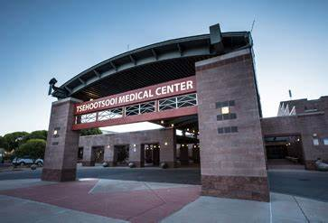
Ahe’hee
Fort Defiance Indian Hospital Board Inc.
fdihb.org | 928.729.8000

